Slide 1





Η κοινωνική διάσταση της υγείας
Grigoris T. Gerotziafas
Directeur de Recherche Cancer-Hémostasis-Angiogenesis
Centre de Recherche Saint Antoine,
Institut National de la Santé et de la Recherche Médicale (INSERM UMRS-938)
Hémostase-Thrombose en Hématologie
Sorbonne Université

Slide 2
Disclosures
Research Support/P.I. | Stago, Leo, Sanofi, Bristol-Myers Squibb, Pfizer
Employee | No relevant conflicts of interest to declare
Consultant | No relevant conflicts of interest to declare
Major Stockholder | No relevant conflicts of interest to declare
Speakers Bureau | No relevant conflicts of interest to declare
Scientific Advisory Board | No relevant conflicts of interest to declare
MAT-BG-2100138_v.1.0_05/2021

Slide 3
MAT-BG-2100138_v.1.0_05/2021

Slide 4

COVID-19 definition
COVID-19 is a systemic, potentially severe and life-threatening disease, triggered by the SARS-CoV-2 infection which involves
  immune and inflammatory responses
  endothelial cell dysfunction
  complement activation
  hypercoagulable state
COVID-19 is an hematological - vascular disease
Gerotziafas et al Thromb Haemost September 2020 DOI: 10.1055/s-0040-1715798

Slide 5


COVID-19
Clinical classification and definition
Critical illness: patients with acute respiratory distress syndrome or sepsis with acute organ dysfunction
Severe illness: patients have fever or suspected respiratory infection, plus one of the following:
  respiratory rate > 30 breaths/min
  severe respiratory distress
  pulse oximeter oxygen saturation ≤93% on room air
Non-severe illness: patients without any of the above conditions
mortality
35% to 45%
Early identification of patients at high risk for clinical deterioration is challenging for
An appropriate management
A positive clinical outcome
5%
15%
80%
https://www.who.int/publications-detail/clinical-management-of-severe-acute-respiratory-infection-when-novel-coronavirus-(ncov)-infection-is-suspected. Last access Nov. 2020; Chen et al. Lancet 2020;395:507-13. ; Huang et al. Lancet 2020;395:497-506. Gerotziafas et al Thromb Haemost September 2020. Zhonghua Liu Xing Bing Xue Za Zhi 2020; 41: 145–51.

Slide 6
Prevalence of risk factors and other comorbidities related to disease worsening in patients hospitalized with COVID-19
Comorbidities | Severe COVID-19 | Critical CODIV-19 | Odds ratio for disease worsening (95% CI)
Current smoking | 4.2% - 6.1% | 3.9% - 5% | 0.71 (0.19-2.68)
Malignancy | 1%-6% | 1.5% - 10% | 1.6 (0.81 - 3.18)
Diabetes | 6% - 25% | 14% - 60% | 2.13 (2.68 - 5.1)
Chronic renal disease | 7 % | 19 % | 2.92 (1.04 - 6.09)
Hypertention | 7% - 39% | 15% - 64% | 3.34 (1.72 - 5.47)
CVD | 1% - 10% | 9% - 40% | 5.19 (3.25 - 8.29)
Respiratory disease | 1% - 8% | 5% - 10% | 5.15 (2.51 - 10.5)
Obesity | 8 % | 31 % | 5.4 (2.77 - 10.67)
CVD: cardiovascular disease
Gerotziafas et al. Thromb Haemost September 2020 DOI: 10.1055/s-0040-1715798
Fried JA, et al Circulation 2020;141(23): 1930–1936. Gerotziafas et al Thromb Haemost 2020 0.1055/s-0040-1716544. Zheng et al. J Infect 2020;81(02):e16–e25 . Khurshid et al Circ Arrhythm Electro- physiol 2018;11(07):e006273. Liu et al. Sci China Life Sci 2020;63(03):364–374. Long et al Am J Emerg Med 2020;38(07): 1504–1507.
Li et al Clin Res Cardiol 2020; 109(05):531–538. Ruan et al Intensive Care Med 2020;46(05):846–848. Wu Z, McGoogan JM. JAMA 2020. Doi: 10.1001/jama.2020.2648
Xu et al. Lancet Respir Med 2020;8(04):420–422

Slide 7
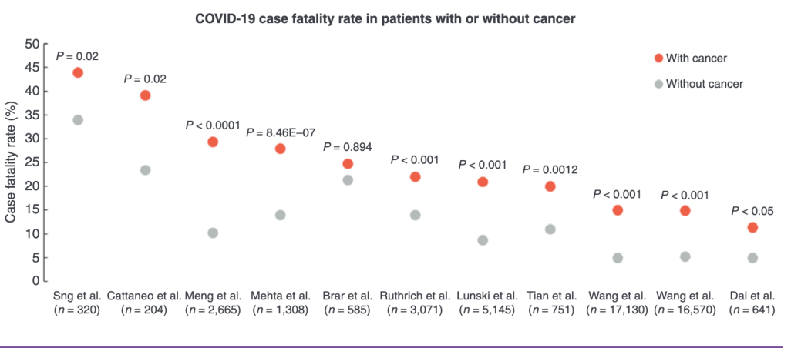
COVID-19 and Cancer
Ribas A, et al. Priority COVID-19 Vaccination for Patients with Cancer while Vaccine Supply Is Limited. Cancer Discov. 2020.

Slide 8

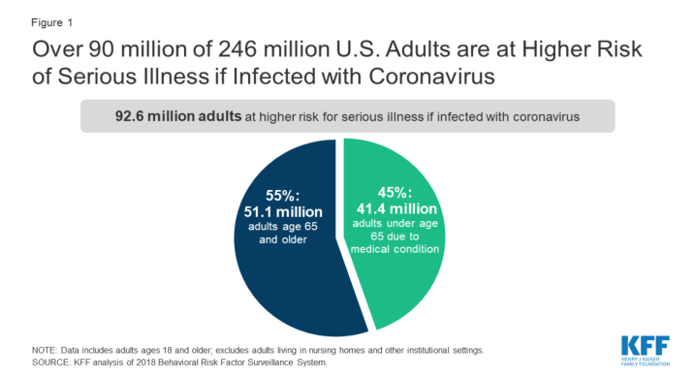
How to find the patients with COVID-19 at risk of disease worsening?
30% - 40% of the USA population
https://www.kff.org/coronavirus-covid-19/issue-brief/how-many-adults-are-at-risk-of-serious-illness-if-infected-with-coronavirus/

Slide 9
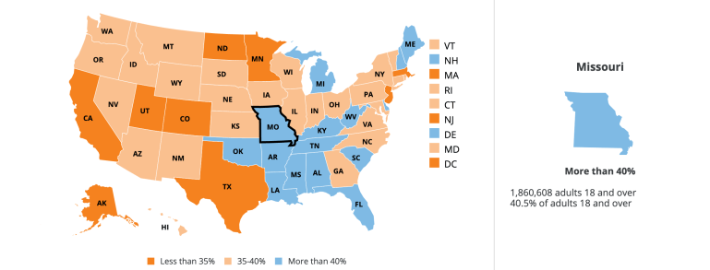
How to find the patients with COVID-19 at risk of disease worsening?
https://www.kff.org/coronavirus-covid-19/issue-brief/how-many-adults-are-at-risk-of-serious-illness-if-infected-with-coronavirus/

Slide 10

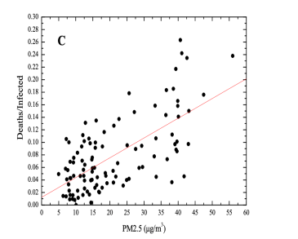
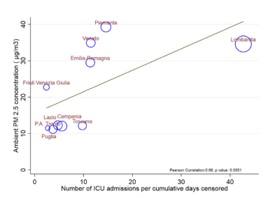
The level of pollution is associated with COVID-19 severity and mortality
PM2.5: particulate matter 2.5 including polycyclicaromatic hydrocarbons, heavy metals and volatile compounds
Frontera A et al J Infect. 2020 Aug;81(2):255-259.
Borro et al. Int J Environ Res Public Health, 2020 Aug 2;17(15):5573.

Slide 11
Symptomatic, objectively documented VTE in hospitalized patients with COVID-19 and VTE-related mortality
Meta-analysis of 49 studies`
Pooled sample of 18,093 patients
Mean age : between 52 and 71 ys
Follow-up duration varied 2 - 55 days
Meta-analysis of 42 studies`
Pooled sample of 8271 patients
Οverall VTE rate : 21%
VTE in ward: 5% (95% CI: 3−8%)
VTE in ICU: 31% (95% CI: 23−39%)
Thromboprophylaxis
None: 21%
Standard dose: 18%
Intermediate or threrapeutic dose 19%
PE
DVT
OR, 1.74; 95%CI, 1.01–2.98; P =0.04
IVTE ncidence (%)
mortality (%)
Jimenez et al. Chest. 2020;S0012-3692(20)35146-1.
Malas et al EClinicalMedicine Volume 29, 100639, December 01, 2020

Slide 12
Incidence of VTE and Mortality in Patients with Initial Presentation of COVID-19
10 871 adults diagnosed with COVID-19 to a large multihospital health system
Within the first eight hours of presentation
1.09% symptomatic VTE (n=118)
  0.93% (n=101) were PE
  0.16%(n=17) were DVT
0.26% mortality rate
Giannis et al J Thromb Thrombolysis 2021 Mar 5 : 1–5.

Slide 13
Dying with COVID-19 and VTE?
Rate of autopsy documented VTE in autopsy study in 80 deceased
40% : VTE
12% : fatal PE + DVT
12% : non fatal PE
15 males also showed thrombi in the prostatic venous plexus
Place of death
10 out of 26 patients (38%) who died at home had VTE
Edler et al. Int J Leg 2020 Jun 4;1-10. doi: 10.1007/s00414-020-02317

Slide 14
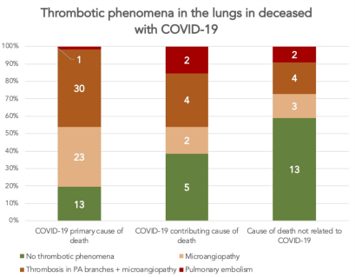
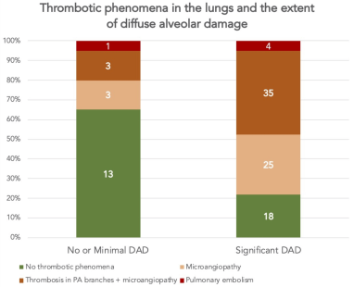
Thrombosis on systematic postmortem studies in patients with positive SARS-CoV2 tissue PCR during the COVID-19 pandemic
Consecutive forensic (n=60) and clinical (n=42) autopsies with positive postmortem SARS-CoV2 PCR in lungs (age 73±14 years, 50% men) were included
Romanova et al. J Intern Med . 2021 Apr 19. doi:10.1111/joim.13300.

Slide 15
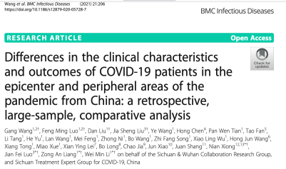
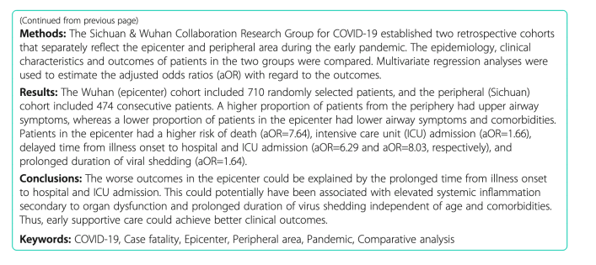

Slide 16

March 2020
COMPASS-COVID-19 project

Slide 17
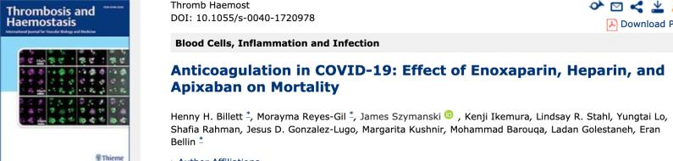
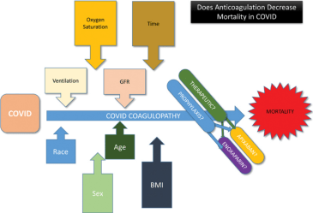
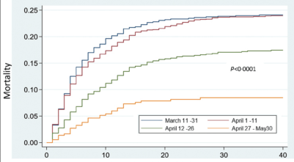
Mortality according to time period on presentation
Decrease of 28 days mortality after early initiation of anticoagulant treatment
apixaban 2.5 bid: OR 0.46, p = 0.001,
apixaban 5 mgx2 bid: OR 0.57, p = 0.006),
enoxaparin 4000 IU od: OR 0.49, p = 0.001

Slide 18


COMPASS-COVID-19 risk assessment model for COVID-19 worsening
COMPASS-COVID-19 RAM
Predictors for risk of worsening disease | Score
Obesity (BMI>30) |  | 19
Male gender |  | 10
Compensated DIC-ISTH score ≥5 |  | 9
Confirmed COVID-19 | 2
Thrombocytopenia (Platelet count < 100.000/μL) | 1
Prothrombin time prolongation (> control+ 3 sec) | 1
D-Dimers increase (>500 for age <60 years ; >600 ng/ml for age 60-59 years ; >600 ng/ml for age 60 - 69 years ; >700 ng/ml for age 70 - 79 years ; >800 ng/ml for age 80 - 89 years ; >900 ng/ml for age 90 - 99) | 1
Antithrombin decrease (<lower normal limit established by the laboratory) | 1
Protein C decrease (<lower normal limit established by the laboratory) | 1
Total
Lymphocytes <10⁹/L |  | 8
Hemoglobin <11 g/dL |  | 8
Total |  | ≥ 18 : high risk < 18 : low risk
Clinical predictors
March 2020
Hypercoagulability
Viral charge, inflammation, hypoxia
94% sensitivity, 58% specificity
Online calculator: www.medupdate.eu
Gerotziafas et al. Thromb Haemost Sept. 2020 DOI: 10.1055/s-0040-1715798

Slide 19
www.medupdate.eu
For the evaluation of the risk for disease worsening
Principle of the Compass Covid-19 score
1. Hypercoagulability, endothelial cell activation and thrombosis, together with the cytokinestorm and the exaggerated inﬂammatory reaction are the major pathological processes leading to coronavirus deseases (COVID-19) worsening.
Start

Slide 20


Timeline for the management of VTE risk in patients with COVID-19
LMWH
Unselected patients: standard prophylactic dose for
Vascular patients: intermediate dose of LMWH
Established VTE risk
IMPROVE D-Di score
High risk patients: LMWH or DOAC at standard prophylactic dose
Cytokine storm
Hypercoagulability
Endothelial cell activation
Complement activation
IMPROVE and COMPASS scores and standard prophylactic dose of High risk patients: LMWH or DOAC
VTE risk
Disease worsening
Viral symptom phase
Inflammatory phase
Exposure to
SARS-CoV-2
Ambulatory
period
Conventional ward
ICU
Post-hospital discharge
Incubation period 2 – 14 d
1st week
Sanofi does not recommend the use of its products in any manner inconsistent with that described in the full prescribing information available in your country. Before prescribing the product always refer to the prescribing information and medical guidance in your country.
Prof. Gerotziafas personal view
Gerotziafas et al Sang Thrombose Vaisseaux 2020;32(6)

Slide 21
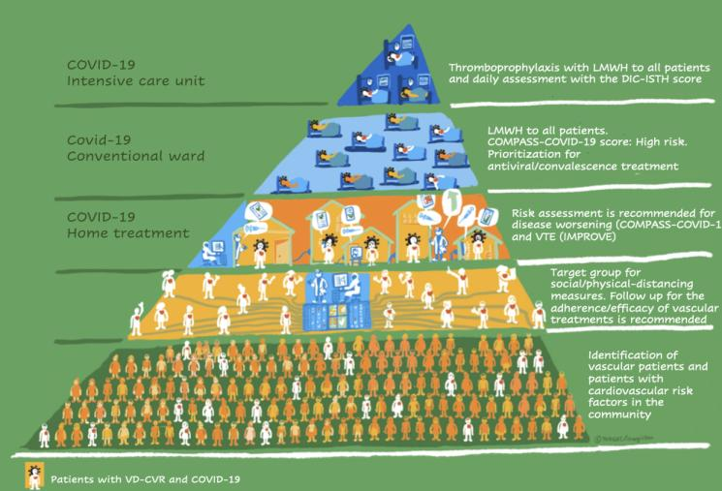
Integral strategy recommended by VAS for the management of patients with vascular disease or cardiovascular risk factors during SARS-CoV-2 epidemic
Gerotziafas et al Thromb Haemost September 2020 DOI: 10.1055/s-0040-1715798
Gerotziafas et al Thromb Hemost September 2020

Slide 22

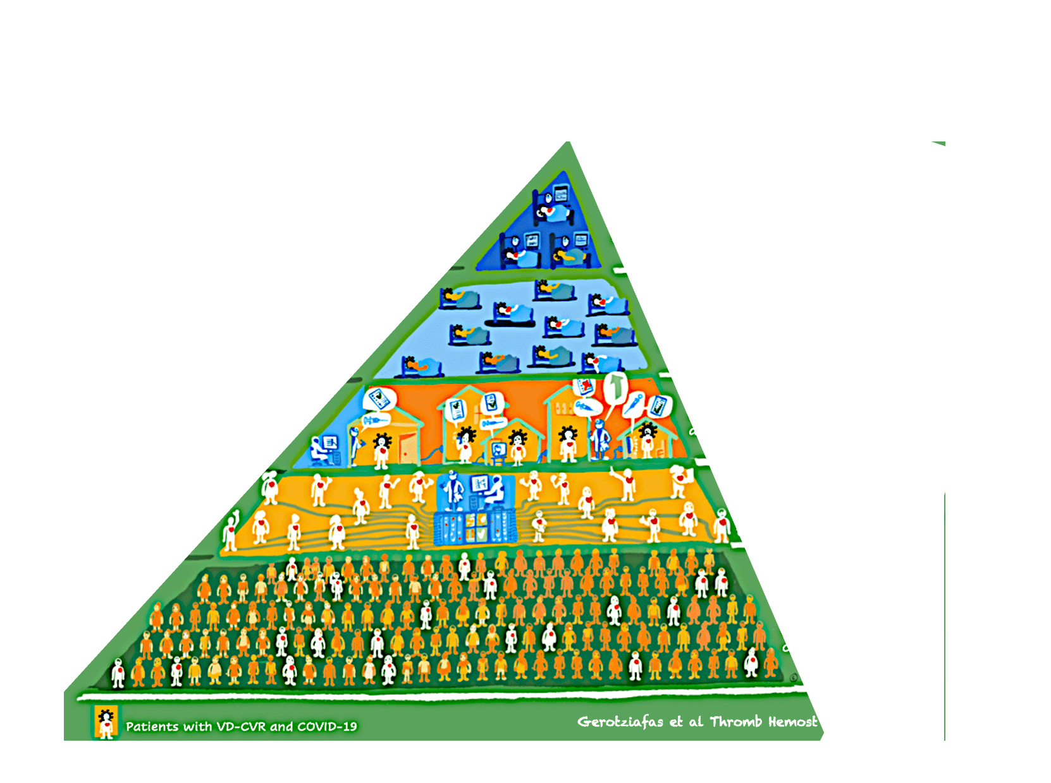

Prevention – Detection – Anticipation
COMPASS-COVID-19 strategy
for an equilibrated management of the pandemic
Primary health care and Hospital Capacity
Local Social
distancing
Targeted Vaccine and Tracing
of SARS-CoV-2 infection

