Slide 1
The value of innovation towards an efficient and sustainable healthcare system
Agata Jakoncic President, Pharma Innovation Forum (PIF)
Managing Director MSD Greece, Cyprus & Malta

Slide 2
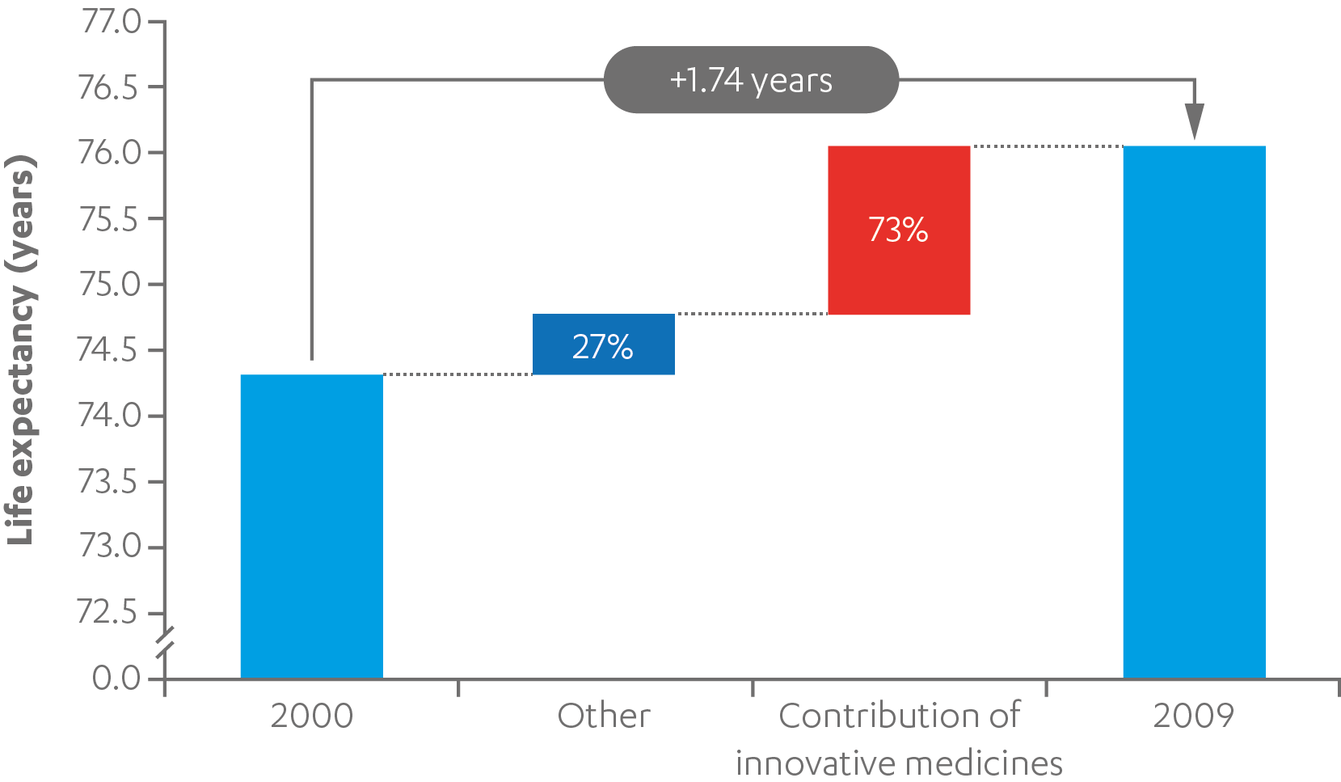
Innovative medicines make the world a better and healthier place
Pharmaceutical innovation contributed ~73% of improvement in life expectancy between 2000–2009
73%
From 2000 to 2009, an improvement in population weighted mean life expectancy at birth of 1.74 years was seen across 30 OECD countries.
While the early rise in life expectancy can be attributed to better and safer living conditions, the second half of the 20th century has seen an explosion in pharmaceutical innovation.
27%
Source: Lichtenberg, F: Pharmaceutical innovation and longevity growth in 30 developing OECD and high–income countries, 2000 – 2009 (2012
Source: https://www.efpia.eu/media/219735/efpia-pharmafigures2017_statisticbroch_v04-final.pdf
Notes:
<αριθμός>

Slide 3
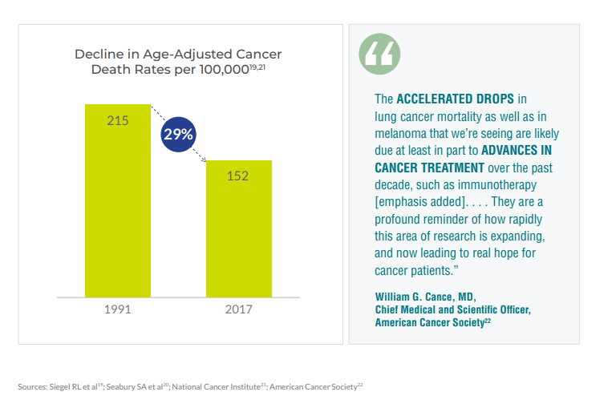
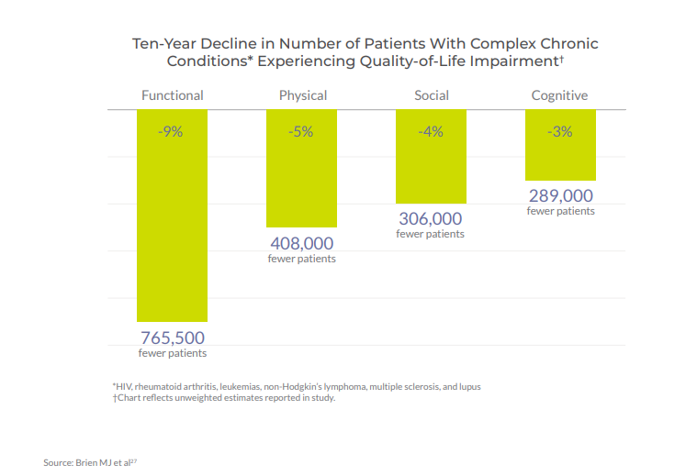
Patients today live longer and feel better due to innovation
Life expectancy
Quality of Life
Source: https://www.phrma.org/-/media/Project/PhRMA/PhRMA-Org/PhRMA-Org/PDF/A-C/ChartPack_Biopharmaceuticals_in_Perspective_Fall2020.pdf
Notes:
Data on life expectancy derive from US based on latest update of American Cancer Society statistics published in 2021
Data on quality of life derive from US data from MEPS database for period 2002-2012 (Brien paper was published in 2016)
<αριθμός>

Slide 4
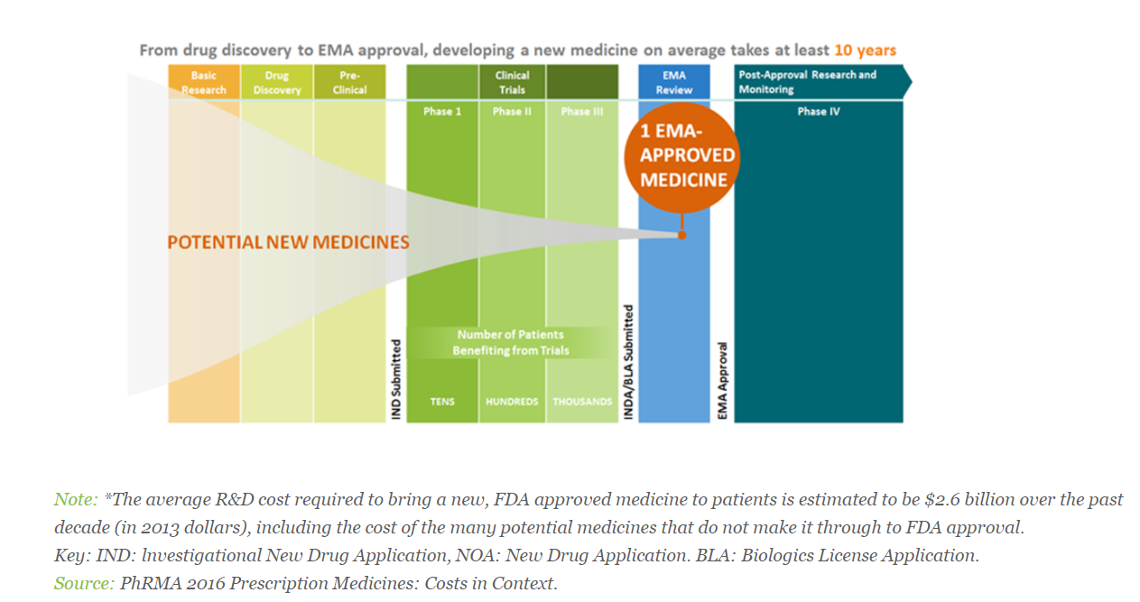
The R&D Process for New Drugs Is Lengthy and Costly, With High Risk of Failure
Source: https://www.efpia.eu/publications/data-center/innovation/research-and-development-process/

Slide 5
Innovation in healthcare goes beyond medicines and leads to a patient centric health ecosystem
Medical knowledge
Medicines
Life long digital assistant
Data to drive precision medicine
Processes
Devices
Healthcare Innovation
New care delivery models
Digital heart twins
Healthcare by mobile phone
AI & better diagnoses
Monitoring
Diagnostic methods
Source: https://www.wipo.int/global_innovation_index/en/2019/health_ai_bigdata.html
Notes:
<αριθμός>

Slide 6
Meet John!
In a patient-centric ecosystem, John – a financially constrained patient with multiple chronic conditions – will have a personalized experience
Common data backbone
(patient- and provider-generated, wellness, financial, etc.)
Advanced analytics technology
(e.g. AI converting John’s data into actionable insights for his health)
Source: https://www.mckinsey.com/industries/healthcare-systems-and-services/our-insights/the-next-wave-of-healthcare-innovation-the-evolution-of-ecosystems
Notes:
<αριθμός>

Slide 7
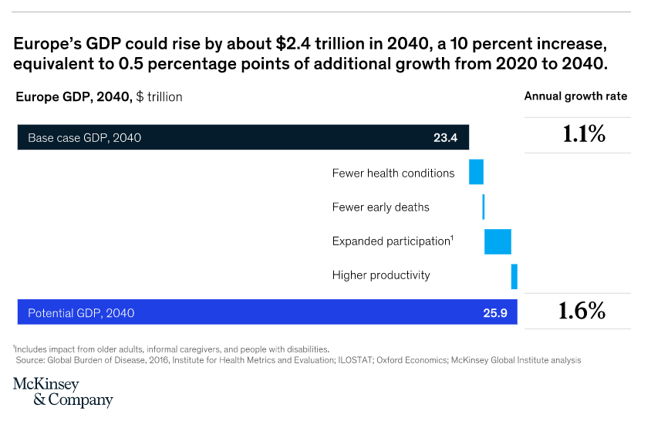
Investing in prevention and innovation in medicines and technologies, to improve health could bring sustainable economic growth
An average 65-year-old in 2040 could be as healthy as a 55-year-old today!
Source: How prioritizing European health is a prescription for prosperity | McKinsey
Notes:
<αριθμός>

Slide 8
The road for innovation is full of roadblocks in Greece: Can RRF bring hope?
Approving innovations in Greece can last at least 2 years
EMA approval
Price submission
Price approval
HTA external criteria fulfillment
HTA assessment
Negotiation process
Publication of the decision
~5 months
~9 months
~4 months
~6 - 12 months
~ 6 months
~ even up to 6 months
There is possibility of earlier access through IFET process, however this applies to limited classes of drugs, is inequitable among patients and is costly for the system
Disincentives for innovation
According to new legislation a new Alzheimer’s drug will have to pay more than 65% obligatory returns on top of legislated rebates upon market entry
Only 50% of the medicines approved in EMA between 2016-2019 are officially reimbursed in Greece
Can RRF reforms bring new hope?

Slide 9
PIF’s 3-year Pharmaceutical Policy Roadmap aims for a sustainable, innovation friendly healthcare system without inequalities and access barriers for patients
Stable and predictable Pricing & Reimbursement system
Open & efficient HTA system and processes
Empowerment of clinical and biomedical research & fund for innovation
Transparency & Monitoring in prescribing and clinical protocols / registries implementation
Sustainable & predictable financing of pharma care
Notes:
<αριθμός>

Slide 10
Thank you !
Notes:
<αριθμός>

Slide 11
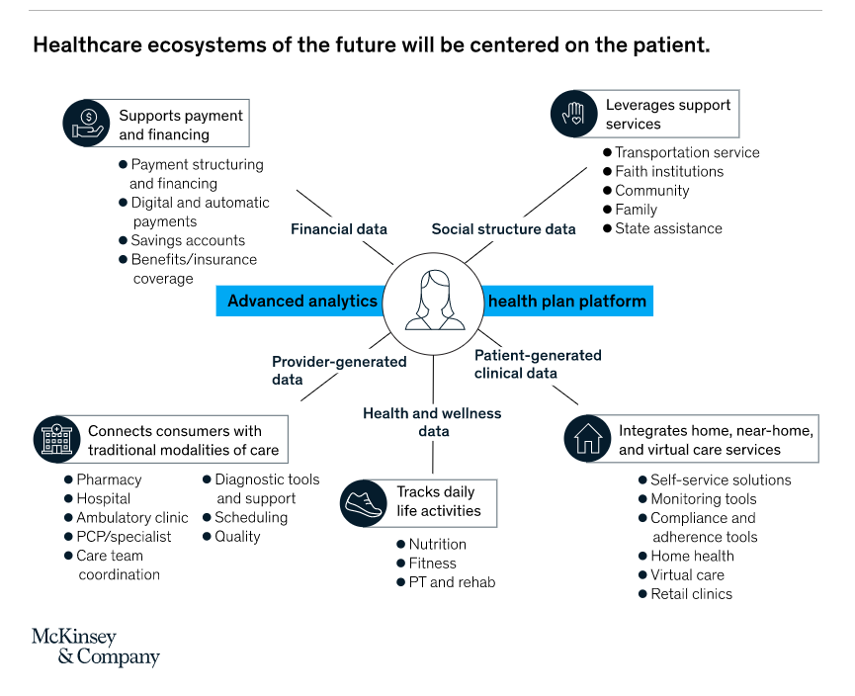
Healthcare innovation in the future would mean building patient-centered ecosystems
Source: https://www.mckinsey.com/industries/healthcare-systems-and-services/our-insights/the-next-wave-of-healthcare-innovation-the-evolution-of-ecosystems
Notes:
<αριθμός>

Slide 12
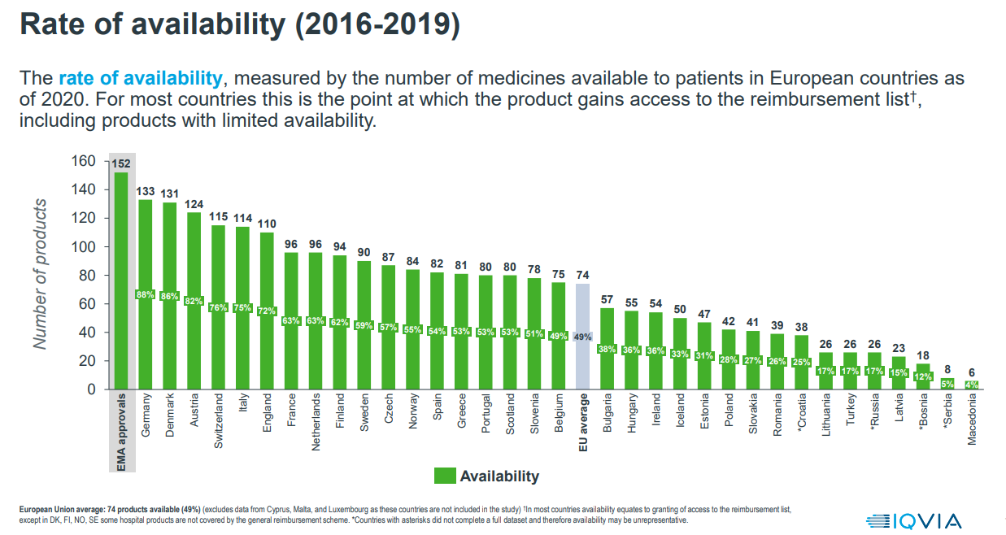
In 2016-2019 Greek patients continued to have access to ~50% of the EMA approved drugs
Source: https://efpia.eu/media/602652/efpia-patient-wait-indicator-final-250521.pdf
Notes:
<αριθμός>

